Slide 1
Computational Physics (Lecture 6)
PHY4061

Slide 2
Matrix Operation

Slide 3
Matrix Operations
Matrix operations
involved in many numerical and analytical scientific problems.
Schemes developed for the matrix problems can be applied to the related problems encountered in ordinary and partial differential equations. What problems in ODE and PDE can be solved by matrix operations?

Slide 4
For example, an eigenvalue problem given in the form of a partial differential equation can be rewritten as a matrix problem.
A boundary-value problem after discretization is essentially a linear algebra problem.

Slide 5
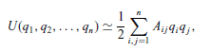
Vibrational spectrum:
N degrees of freedom
The harmonic oscillations of the system
Expanding the potential energy up to the second order of the generalized coordinates around the equilibrium
The potential energy:
qi are the generalized coordinates and Ai j are the elements of the generalized elastic constant matrix

Slide 6
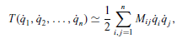
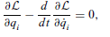
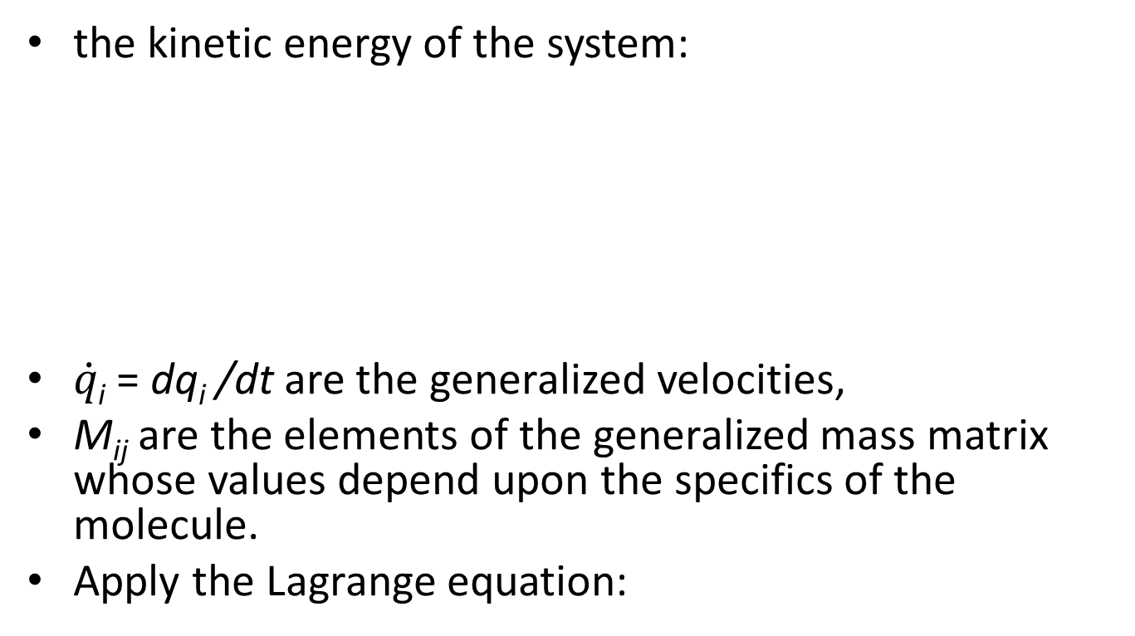
One simple example
the kinetic energy of the system:
$\dot{q\text{i}}$ = dq_{i} /dt are the generalized velocities,
M_{ij} are the elements of the generalized mass matrix whose values depend upon the specifics of the molecule.
Apply the Lagrange equation:

Slide 7
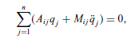
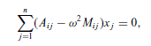
L= T-U is the lagrangian of the system.
If we assume that the time dependence of the generalized coordinates is oscillatory with
q_{j}= x_{j} e ^{−iωt} , we have:

Slide 8

In matrix form:
Or Ax=λMx, where λ is the eigenvalue, x is the eigenvector.
The determinant of the coefficient has to vanish: |A-λM|=0

Slide 9
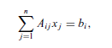

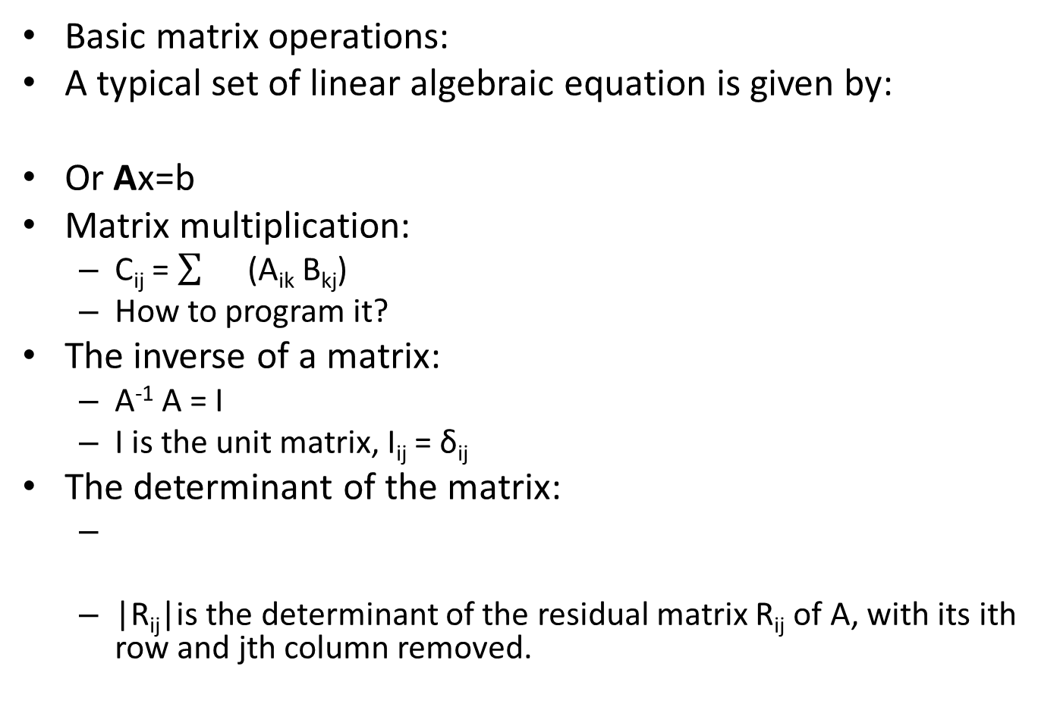
Basic matrix operations:
A typical set of linear algebraic equation is given by:
Or Ax=b
Matrix multiplication:
C_{ij} = (A_{ik} B_{kj})
How to program it?
The inverse of a matrix:
A⁻¹ A = I
I is the unit matrix, I_{ij} = δ_{ij}
The determinant of the matrix:
|R_{ij}|is the determinant of the residual matrix R_{ij} of A, with its ith row and jth column removed.

Slide 10
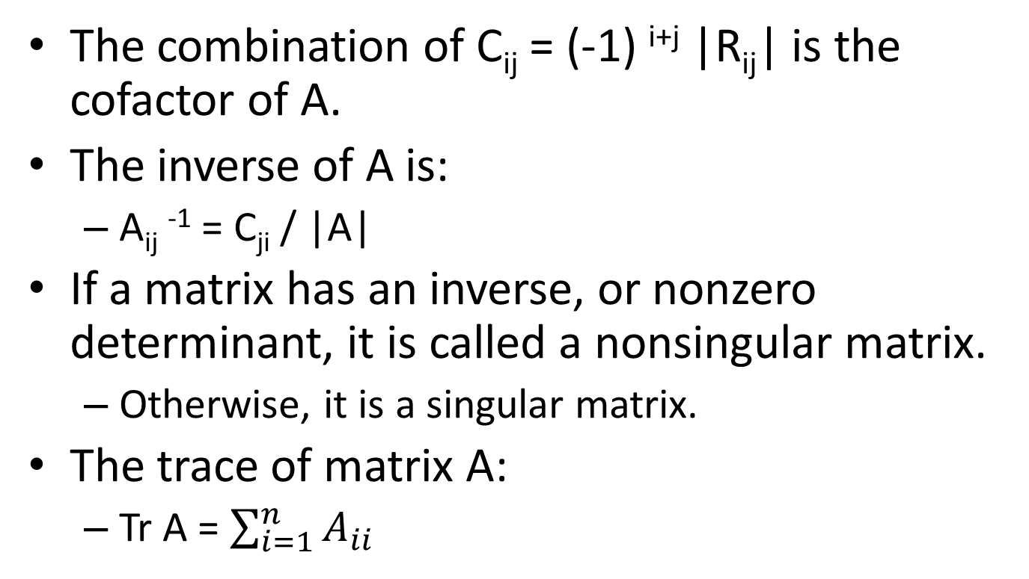
The combination of C_{ij} = (-1) ^{i+j} |R_{ij}| is the cofactor of A.
The inverse of A is:
A_{ij} ⁻¹ = C_{ji} / |A|
If a matrix has an inverse, or nonzero determinant, it is called a nonsingular matrix.
Otherwise, it is a singular matrix.
The trace of matrix A:
Tr A = $\sum_{i=1}^{n}{A_{ii}}$

Slide 11
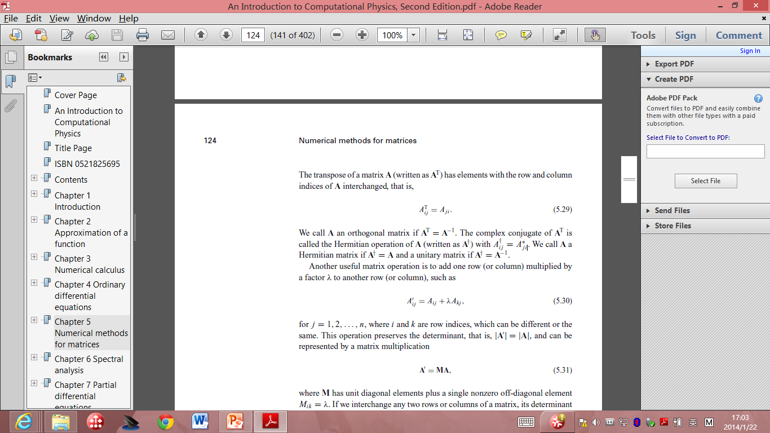

The transpose of a matrix: A^{T} has the elements with the row and column indices of A interchanged.
A_{ij}^{T}= A_{ji}
A is orthogonal if A^{T} = A⁻¹
The complex conjugate of A^{T} is called the Hermitian operation of A.
: Hermitian matrix
: unitary matrix.

Slide 12
Eigen value problem:
Ax = λx
x : eigen vector, λ: eigen value.
One way to solve it is to use recursion:
A x^{k+1} = λ ^{k}x^{k}
Here λ^{k} and x^{k} are the approximate eigenvalue and eigenvector at the kth iteration. Iteration method.

Slide 13
Linear Equating Problem
Upper-triangular (lower-triangular) matrix
the elements below (above) the diagonal are all zero.
The simplest scheme for solving matrix problems ( Gaussian elimination)
basic matrix operations to transform the coefficient matrix into an upper (lower) triangular first
finds the solution by backward (forward) substitutions.

Slide 14
The basic idea of Gaussian elimination
transform the original linear equation set to one that has an upper-triangular or lower-triangular coefficient matrix with the same solution.
The final linear equation set:
A^{(n−1)}x = b^{(n−1)}, with A^{(n−1)} _{ij} =0 for i > j.

Slide 15
Procedure
multiply the first equation by −A(0)_{i1} /A(0) ₁₁ , that is, all the elements of the first row in the coefficient matrix and b(0) ₁ , and then add it to the ith equation for i > 1.
The first element of every row except the first row in the coefficient matrix is then eliminated.
Repeat the procedure from row 2….
What potential problems of this algorithm?

Slide 16
One Concern
The scheme fails if any of the diagonal elements are zero…
Interchange rows or columns to have the elements for divisions being as large as possible.
So called pivoting procedure.
Partial pivoting:
Search for the pivoting element only from the remaining elements of the given column.
Good compromise of computing speed and accuracy.

Slide 17
We don’t have to interchange the row in the program
Because it is inefficient.
How do you propose an algorithm to solve this problem?

Slide 18
// Method to carry out the partial-pivoting Gaussian
// elimination. Here index[] stores pivoting order.
public static void gaussian(double a[][],
int index[]) {
int n = index.length;
double c[] = new double[n];
// Initialize the index
for (int i=0; i<n; ++i) index[i] = i;
// Find the rescaling factors, one from each row
for (int i=0; i<n; ++i) {
double c1 = 0;
for (int j=0; j<n; ++j) {
double c0 = Math.abs(a[i][j]);
if (c0 > c1) c1 = c0;
}
c[i] = c1;
}
// Search for the pivoting element from each column
int k = 0;
for (int j=0; j<n-1; ++j) {
double pi1 = 0;
for (int i=j; i<n; ++i) {
double pi0 = Math.abs(a[index[i]][j]);
pi0 /= c[index[i]];
if (pi0 > pi1) {
pi1 = pi0;
k = i;
}
}

Slide 19
// Interchange rows according to the pivoting order
int itmp = index[j];
index[j] = index[k];
index[k] = itmp;
for (int i=j+1; i<n; ++i) {
double pj = a[index[i]][j]/a[index[j]][j];
// Record pivoting ratios below the diagonal
a[index[i]][j] = pj;
// Modify other elements accordingly
for (int l=j+1; l<n; ++l)
a[index[i]][l] -= pj*a[index[j]][l];
}
}
}
The above method destroys the original matrix. If we want to preserve it, we can
just duplicate it

Slide 20
Determinant of a matrix
The determinant of the original matrix can easily be obtained after we have transformed it into an upper-triangular matrix through Gaussian elimination.
the procedure used in the partial-pivoting Gaussian elimination does not change the value of the determinant only its sign
can be fixed with the knowledge of the order of pivoting elements.
For an uppertriangular matrix, the determinant is given by the product of all its diagonal elements.

Slide 21
// Method to evaluate the determinant of a matrix.
public static double det(double a[][]) {
int n = a.length;
int index[] = new int[n];
// Transform the matrix into an upper triangle
gaussian(a, index);
// Take the product of the diagonal elements
double d = 1;
for (int i=0; i<n; ++i) d = d*a[index[i]][i];
// Find the sign of the determinant
int sgn = 1;
for (int i=0; i<n; ++i) {
if (i != index[i]) {
sgn = -sgn;
int j = index[i];
index[i] = index[j];
index[j] = j;
}
}
return sgn*d;
}
public static void gaussian(double a[][],
int index[]) {...}
}
// An example of evaluating the determinant of a matrix
// via the partial-pivoting Gaussian elimination.
import java.lang.*;
public class Det {
public static void main(String argv[]) {
double a[][]= {{ 1, -3, 2, -1, -2},
{-2, 2, -1, 2, 3},
{ 3, -3, -2, 1, -1},
{ 1, -2, 1, -3, 2},
{-3, -1, 2, 1, -3}};
double d = det(a);
System.out.println("The determinant is: " + d);
}
// Method to evaluate the determinant of a matrix.
public static double det(double a[][]) {
int n = a.length;
int index[] = new int[n];

Slide 22
solve a linear equation set after transforming its coefficient matrix into an upper-triangular matrix through Gaussian elimination.
The solution is then obtained through backward substitutions.

Slide 23
An Overview on Inter-atomic Potentials
Simulation results are only as good as the potentials (forces) that are used.
It is not an easy problem to get accurate forces because the origin of forces is quantum mechanics, to date a computationally intractable problem, but there has been some recent progress.
The most common approach is semi-empirical: a functional form is guessed or deduced and parameters are fitted from experimental data or ab initio potentials calculated for a model system.

Slide 24
The Born-Oppenheimer Approxiamtion
How do we define the potential to be used?
The fundamental description is in terms of the non-relativistic Schröedinger equation for both the ionic and electronic degrees of freedom.
But since the electrons are much lighter they respond more-or-less instantly to the ionic motion.
Also typical temperatures are very cold compared to the electronic energy scale (1 Hartree, which sets the scale of the electronic energy, equals 316,000 K)
so the electrons are in or close to their ground state.

Slide 25
In the Born-Oppenheimer (BO) approximation we fix the ions (and neglect the nuclear kinetic energy) and solve (or try to solve) for the electronic ground state energy.
Corrections to BO are usually very small because corrections go as the ratio of the electron to nuclear mass which is smaller than 0.0001 for all atoms except hydrogen and helium.

Slide 26
Unfortunately solving for the quantum mechanics is not very easy to do!
The most popular methods are the density functional theory (and improvements such as the GGA theory), quantum chemistry methods such as Hartree-Fock theory and the configuration interaction method. Another (accurate) method is quantum Monte Carlo.

Slide 27
One break-though occurred fifteen years ago when Car and Parrinello (CP) showed how one could simultaneously solve the LDA equation for the electronic energy and the dynamical equations for the nuclei.
This means one does not have to tabulate the BO energy but just compute it as the ions move. We will describe this method later in the course. But the CP approach is very much slower than using fitted potentials (about 4 orders of magnitude). The largest CP studies have several hundreds of electrons or atoms while the largest MD simulation have millions of particles.

Slide 28
Unless we use the CP approach then we have to assume some form for the potential.
The assumption of a potential is a big approximation!
the potential energy surface is a function of 3N variables for N ions.
Symmetries such as translational degrees or rotational of freedom will only get rid of a few degrees of freedom.
What usually has to be done is to assume the many-body potential is a sum of pair potentials and perhaps three-body potentials etc.
This also assumes the molecule is rigid and weakly interacting with the environment so its internal electronic state does not couple with surrounding molecules.
A pair potential is a function of a single variable; there is no way it can exactly represent a 3N dimensional function.

Slide 29
So where do we get the pair potentials from?
The basic input is theoretical as we will discuss. The other input is empirical. Some sources of experimental data are:
atom-atom scattering in the gas phase can give direct information about the atom-atom potential. The scattering energy samples different regions of the interaction depending on the energy of the colliding atoms.

Slide 30
gas phase data, for example the virial coefficients and transport properties give integrals over the potential.
the low temperature thermodynamic properties. Most materials (except helium) form a solid at low temperature.
If the energy as a function of density is known, that gives fairly direct information about the depth of the potential well and its curvature.

Slide 31
high pressure information.
This samples the interaction at shorter distances than at lower pressures.
thermodynamic data,
such as melting temperature, the critical point and the triple point. This information is harder to use directly as it is many-body property. But one can use simulations to compute a phase diagram with a trial potential, then try to change the potential using perturbation theory to make the trial phase diagram agree with the actual phase diagram.

Slide 32
The difference between interpolation and extrapolation.
If experimental information is used to determine the potential, it will be good in a nearby region of phase space and for similar properties.
But that potential could be quite bad for unrelated properties or outside the region that has been fitted.
For example, if the potential has been determined using bulk properties, there is no reason to think it will be good to compute surface properties because the local environment on a surface is not as symmetrical as in the bulk.

Slide 33
Molecular Solids: The Noble Gases
These are the rare gases where the electronic shells are closed.
This means they are spherical atoms. They were the first systems to be simulated and the pair potentials work best for them!
At large distances one can understand the interactions by considering how two oscillators would interact, giving the r ⁻⁶ attraction where the coefficient is determined by the atomic polarizability.

Slide 34
On the other hand at short distances, the potentials are strongly repulsive because of the Pauli exclusion principle (electrons are fermions).
Lennard-Jones assumed a stronger inverse power, conveniently r ⁻¹². One should not think the LJ potential is anything more fundamental than this.

Slide 35
Even for Argon it is only accurate to 10% or so. And three-body potentials can be significant at the 10% level.
The potentials that are fit to bulk data are really effective potentials and could be somewhat different than the real 2-body potential that would be determined from gas-phase data because they include correction for three- and higher-body interactions. Hence the effective potentials can be dependent on density and less so on temperature.

